Slide 1
A Manager’s View Of Database Management
Lecture 2
Dr. Taysir Hassan Abdel Hamid

Slide 2
A Manager’s View Of Database Management
Data Resource Management :
Organization could not succeed without quality data about their internal operations and external environment
Managers needs better information due to rapidly changing markets
That’s why organization and managers need to practice Data Resource Management .

Slide 3
A Manager’s View Of Database Management
Definition: The Activity that applies information technology and management tools to manipulate the data resources to meet the information needs of business users
In order To Practice Data Resource Management we must learn about
Database management Technology
Methods to manage an organization’s data
The Concepts Of Database Administration
Data Planning

Slide 4
Data Concepts
Character-Field-Record-File-Database
Personnel Database
Payroll File
Benefits File
Employee Record 1 | Employee Record 2 | Employee Record 3 | Employee Record 4
Name Salary Field Field

Slide 5
Database management
Definition data records into databases which can be accessed by different application programs.
Tools: database and database management software an important software package called Database Management System (DBMS) serves as a software interface between users and database.

Slide 6
Database management
Example: customer data in a bank are needed for several applications
“check processing, bank credit cards, saving accounts, loan accounts,…etc”
These data can be consolidated in a CUSTOMER DATABASE

Slide 7
Inquiry
Customer Transaction Processing
Checking
Account
Program
Savings
Account
Program
Installment
Loan
Program
Database Management System
Checking Account Data
Saving Account Data
Installment Loan Data
Other Customer Data
Customer Database

Slide 8
Database Management involves 3 basic activities
Updating and maintaining database
Providing the needed information for End users using application programs
Providing inquiry and reporting

Slide 9
Types Of Database
External
Databases
from
online
Data banks
End User Workstation
Distributed
Databases
at other
Locations
Database
Server
Operational
Databases
of the
Organization
End User
Database
Data
Warehouse
Databases
Analytical
Databases
of Critical
Organization
Data

Slide 10
OPERATIONAL DB
ANALYTICAL DB
Detailed data needed to support the operations of the entire organization
They are also called:
Subject area database (SADB)
Translation databases
Production databases
Information extracted from other database needed by manager and end users.
They are also called
Management databases
Information databases
Multidimensional database
This type of databases accessed by using the online analytical processing systems (OLAP), Decision
support systems (DSS)

Slide 11
WAREHOUSE DB
DISTRIBUTED DB
Stores data from current and previous years. It is a central source of data
These are databases of workgroups and departments at regional offices.
It includes segments of both common operational and common user databases

Slide 12
END USER DB
EXTERNAL DB
Consists of a variety of data files developed by end users at there workstations such as documents generated by word processing packages as received by E-mail on data files generated from using different spreadsheets.
Access to external online databases as databanks such as many sources as the internet

Slide 13
Data Concepts
Character-Field-Record-File-Database
Personnel Database
Employee
Training
Data
Employee
Insurance
Coverage
Data
Employee
Salary
Data
Employee
Job Performance
Data

Slide 14
Database Management Approach
The database Management Approach consolidates data records into databases that can be accessed by many different application programs called Database Management System (DBMS)
i.e DBMS serves as software interface between users and databases.

Slide 15
Database management
Example: customer data in a bank are needed for several applications
“check processing, bank credit cards, saving accounts, loan accounts,…etc”
These data can be consolidated in a CUSTOMER DATABASE

Slide 16
Inquiry
Customer Transaction Processing
Checking
Account
Program
Savings
Account
Program
Installment
Loan
Program
Database Management System
Checking Account Data
Saving Account Data
Installment Loan Data
Other Customer Data
Customer Database

Slide 17
Using Database Management Software
Database Management Software is a set of computer programs that controls the creation, maintenance, and use of database.
There are four major DBMS uses:
1 -Database development
2 -Database interrogation (requery)
3 -Database maintenance
4 -Application development

Slide 18
Thus Database Management Approach involves 3 basic activities
Providing the needed information for EU using application programs
Providing inquiry and reporting
Updating and maintaining database

Slide 19
Types of Database
External
Databases
from
online
Data banks
End User Workstation
Distributed
Databases
at other
Locations
Database
Server
Operational
Databases
of the
Organization
End User
Database
Data
Warehouse
Databases
Analytical
Databases
of Critical
Organization
Data

Slide 20
TEXT DB
MULTIMEDIA DB
Store bibliographic information such as publications and other types of documents
Store a wide variety of images and video sequence as digitized images.
Useful in document image processing through scanning of business documents

Slide 21
Managerial considerations for data resource Management
Benefits and Limitations of Database Management:
Increased technological complexity
Developing large database and installing a DBMS can be difficult and expensive
More Hardware is required
Longer processing times
Vulnerability of centralized database
Data inconsistency of distributed databases

Slide 22
Managerial considerations for data resource Management
Data Resource Management
Data
Administration
Data planning
Data base
Administration

Slide 23
Managerial considerations for data resource Management
Database Administration
Conduct a physical data base design
Conduct a logical data base design
Conduct database tuning and capacity planning
Establish and maintain a data dictionary
Evaluate and select database hardware and software

Slide 24
Managerial considerations for data resource Management
Data Planning
Prepare strategic and technical database plans
Identify opportunities for data sharing and potential database applications
Set procedures for data retention
Set and enforce operational procedures and standards

Slide 25
Managerial considerations for data resource Management
Data Administration
Develop and enforce polices governing data ownership and access control
Conduct organizational data resource requirements planning
Develop an organizational data model and data architecture

Slide 26
Technical Foundations of Database Management (data base Designing)
In all Information systems,data resources must be structured in a logical manner so that they can be accessed easily.

Slide 27
Database Structures
Database Structures Or models refer to the relationships among records stored in database
The database management system packages are designed to use a specific data structure.

Slide 28
Fundamental database Structures
Hierarchical
Network
Relational
Object-oriented
Multidimensional

Slide 29
Hierarchical Structures
The relationships between records form a hierarchical or treelike Structures.
All records are arranged in multilevel Structures consisting of one root record and any number of sub trees levels
All Relationships among records are one -to- many

Slide 30



Course Title
Root
Sub Root
Prerequisite
Date Location
Sub Root
Student
Teacher
Name
Name Grade

Slide 31
Department
Data Element
Hierarchical Structure
Project A
Data Element
Project B
Data Element
Employee1
Data Element
Employee 2
Data Element

Slide 32
Network Structures
The Network model can access the data element by following one of several paths. Any record can be related to many number of other data elements

Slide 33
Network Structures
Relationships are many-to -many
Record
Supplier(S)
Part(P)
Link S-SP
P-SP
It Consists of two sets
Record Set
Links set
Each link have two kind of records
Quality
SP

Slide 34
Department A
Network Structure
Department B
Employee
1
Employee
2
Employee
3
Project
A
Project
B

Slide 35
Network Structure
Department records can be related to more than one employee record
employee record can be related to more than one project record

Slide 36
Relational Structure
The most popular Structure
All Records stored in the form of tables
Retrieve of data by operator is also in the form of table

Slide 37
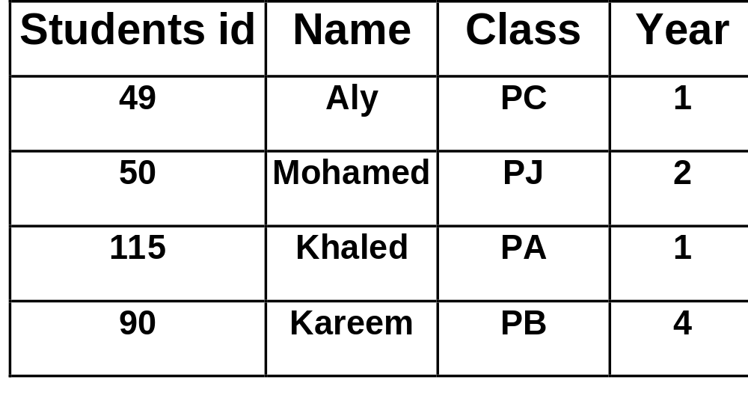
A Given Table

Slide 38
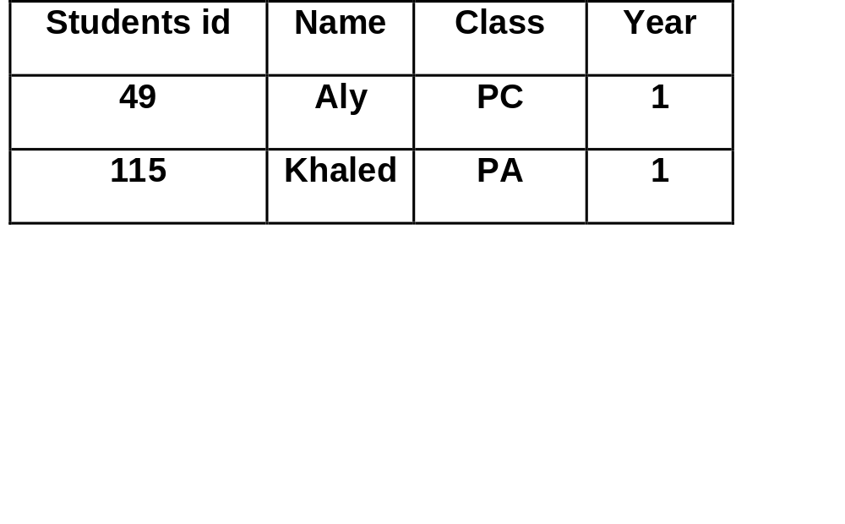
B) Operators
SELECT STUDENT ID,NAME,CLASS,YEAR FROM STUDENT WHERE YEAR=1;
Row Subsets

Slide 39

B) Operators
SELECT Name,YEAR FROM STUDENT WHERE YEAR=1;
Column Subsets

Slide 40
Object-Oriented Structure
This Structure Provide capabilities missing from hierarchical , network, and relational Structures
What is object:An object consists of data and the action that can be performed on the data
Example: Bank Account object consists of data values + the operation performed upon the data

Slide 41
Object-Oriented Structure
(1) Bank Account Object
Attributes
Customer
Balance
Interest Operations
Deposit(amount)
Withdraw(amount)
Get Owner

Slide 42
Object-Oriented Structure
(2)Checking Account Object
Attributes
Credit line
Monthly Statement Operations
Calculate interest owed
Print monthly statement

Slide 43
Object-Oriented Structure
(3)Saving Account Object
Attributes
Number of withdrawals
Quarterly statement Operations
Calculate interest Paid
Print Quarterly statement

Slide 44
Object-Oriented Structure
(1) Bank Account Object
Attributes
Operation
New objects can be automatically created.
Both inherit the common attributes and operations of the parent bank account object.
(2)Checking Account Object
(3)Saving Account Object
Attributes
Operation
Attributes
Operation

Slide 45
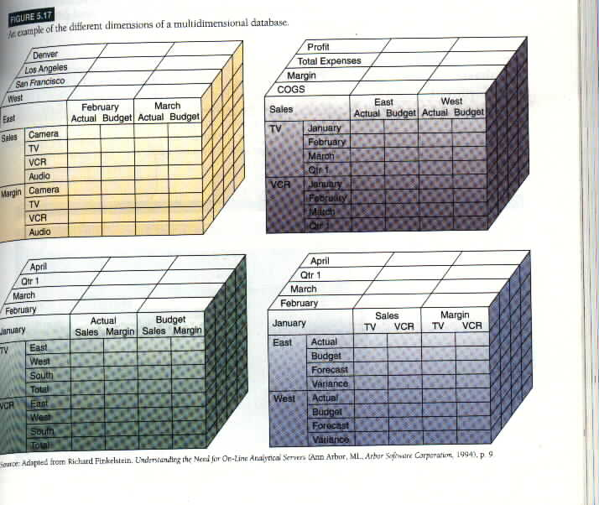
Multidimensional Structure

Slide 46
Multidimensional Structure
Cubes of data and cubes within cubes of data
Each side of the cube is considered a dimension of the data
Each cell contain data related to elements along each dimensions
This structure are compact and easy to understand

Slide 47
Evaluation of Database Structures
The Hierarchical Structures
Is a natural model used for Structured routine types of transaction processing where the data of many operations can be represented in related groups of records (one-To-many)

Slide 48
Evaluation of Database Structures
If the records do not have tree relationships, for example employees from more than one department can work in the one project, in this case the network Structure could handle this many-to-many relationship.

Slide 49
Evaluation of Database Structures
In both structures(Hierarchical and network) the relationships between records must be specified in advance.
For this reason they cannot easily handle ad hoc requests for information

Slide 50
Evaluation of Database Structures
In Relational database structure not all of the Relationships between the data elements need to be specified when the database is created.
So, it allows the end user to easily receive ad hoc request information

Slide 51
Evaluation of Database Structures
Database Software [ORACLE , DB2, Access]create new tables of data relationships using part of data from several tables

Slide 52
Important
Relational database are
-Easier for Programmers
-Easier to work with
-Easier to maintain than the hierarchical and network

Slide 53
But
Cannot Process large amounts of transactions as quickly and efficiently as those based on hierarchical and network types

Slide 54
This performance gap was decreased
by the use of Database Management Software (DBMS)
based on the object-oriented and multidimensional models

Slide 55
Database Development
Large database
Is the responsibility of the:
Small Personal database
1- Database administrator
2- Database designer
3- End users
4- System Analysts
They work together to determine
Microcomputer database Packages
(Microsoft Access)
A-What data definitions should be included in the database
B-What Structure should exist among the data elements.

Slide 56
Developing Database start with top-down data-planning process
Designing
a Database
Changing
a Database
Creating
a Database
Retrieving
Data from
a Database
Entering
Data into
a Database
Generating
Reports from
a Database

Slide 57
1-Data Planning
Develop a model of business
processes
Physical Data Models
Storage representations and
access methods
Enterprise model of business
processes with documentation
5- Physical Design
Determines the Data storage
structures and access
methods
2-Requirements Specification
Define information needs of end
users in a business process
Logical Data Models
e.g. relational,network,
hierarchical,multidimensional,
or object-oriented models
Description of user’s needs may
be represented in natural
language or using the tools of a
particular design methodology.
4- Logical Design
Translates the conceptual
models into the data model of
a DBMS
3-Conceptual design
Expresses all information
requirements in the form of a
high-level model.
Conceptual Data Models
often expressed as entity
relationship models

Slide 58
Thank You

